Slide 1
Object Oriented Programming

Slide 2
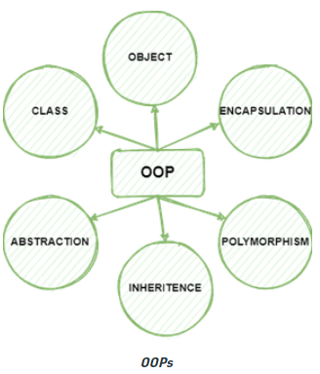
OOP Features
Main Concepts of Object-Oriented Programming (OOPs)
Class
Objects
Polymorphism
Compile-Time (Function Overloading, Operator Overloading)
Run-Time (Method Overriding)
Encapsulation
Inheritance
Data Abstraction
Notes:
2

Slide 3
OOP, Defining a Class
Python was built as a procedural language
OOP exists and works fine, but feels a bit more "tacked on"
Java probably does classes better than Python (gasp)
Declaring a class:
class name:
statements
Notes:
3

Slide 4
Fields
point.py
1 2 3 | class Point: x = 0 y = 0
name = value
Example:
class Point:
x = 0
y = 0
# main
p1 = Point()
p1.x = 2
p1.y = -5
can be declared directly inside class (as shown here) or in constructors (more common)
Python does not really have encapsulation or private fields
relies on caller to "be nice" and not mess with objects' contents
Notes:
4

Slide 5
Using a Class
point_main.py
1 2 3 4 5 6 7 8 9 10 | from Point import * # main p1 = Point() p1.x = 7 p1.y = -3 ... # Python objects are dynamic (can add fields any time!) p1.name = "Tyler Durden"
import class
client programs must import the classes they use

Slide 6
Object Methods
def name(self, parameter, ..., parameter):
statements
self must be the first parameter to any object method
represents the "implicit parameter" (this in Java)
must access the object's fields through the self reference
class Point:
def translate(self, dx, dy):
self.x += dx
self.y += dy
...
Notes:
6

Slide 7
"Implicit" Parameter (self)
Java: this, implicit
public void translate(int dx, int dy) {
x += dx; // this.x += dx;
y += dy; // this.y += dy;
}
Python: self, explicit
def translate(self, dx, dy):
self.x += dx
self.y += dy
Exercise: Write distance, set_location, and distance_from_origin methods.
Notes:
7

Slide 8
Exercise Answer
point.py
1 2 3 4 5 6 7 8 9 10 11 12 13 14 15 16 17 | from math import * class Point: x = 0 y = 0 def set_location(self, x, y): self.x = x self.y = y def distance_from_origin(self): return sqrt(self.x * self.x + self.y * self.y) def distance(self, other): dx = self.x - other.x dy = self.y - other.y return sqrt(dx * dx + dy * dy)

Slide 9
Calling Methods
A client can call the methods of an object in two ways:
(the value of self can be an implicit or explicit parameter)
1) object.method(parameters)
or
2) Class.method(object, parameters)
Example:
p = Point(3, -4)
p.translate(1, 5)
Point.translate(p, 1, 5)

Slide 10
Constructors
Constructors are generally used for instantiating an object. The task of constructors is to initialize(assign values) to the data members of the class when an object of the class is created.
def __init__(self, parameter, ..., parameter):
statements
a constructor is a special method with the name __init__
Example:
class Point:
def __init__(self, x, y):
self.x = x
self.y = y
...
How would we make it possible to construct a Point() with no parameters to get (0, 0)?
Notes:
10

Slide 11
toString and __str__
def __str__(self):
return string
equivalent to Java's toString (converts object to a string)
invoked automatically when str or print is called
Exercise: Write a __str__ method for Point objects that returns strings like "(3, -14)"
def __str__(self):
return "(" + str(self.x) + ", " + str(self.y) + ")"

Slide 12
Complete Point Class
point.py
1 2 3 4 5 6 7 8 9 10 11 12 13 14 15 16 17 18 19 20 21 | from math import * class Point: def __init__(self, x, y): self.x = x self.y = y def distance_from_origin(self): return sqrt(self.x * self.x + self.y * self.y) def distance(self, other): dx = self.x - other.x dy = self.y - other.y return sqrt(dx * dx + dy * dy) def translate(self, dx, dy): self.x += dx self.y += dy def __str__(self): return "(" + str(self.x) + ", " + str(self.y) + ")"

Slide 13
Python Class and Object Example1
Dog.py
1 2 3 4 5 6 7 8 9 10 11 12 13 14 15 16 17 18 19 20 21 | class Dog: # class attribute attr1 = "mammal" # Instance attribute def __init__(self, name): self.name = name # Object instantiation Rodger = Dog("Rodger") Tommy = Dog("Tommy") # Accessing class attributes print("Rodger is a", Rodger.attr1) print("Rodger is a", Tommy.attr1) # Accessing instance attributes print("My name is", Rodger.name) print("My name is", Tommy.name)

Slide 14
Python Class and Object Example2
Dog1.py
1 2 3 4 5 6 7 8 9 10 11 12 13 14 15 16 17 18 19 20 21 | class Dog1: # class attribute attr1 = "mammal“ # Instance attribute def __init__(self, name): self.name = name def speak(self): print("My name is {}".format(self.name)) # Object instantiation Rodger = Dog1("Rodger") Tommy = Dog1("Tommy") # Accessing class methods Rodger.speak() Tommy.speak()

Slide 15
Encapsulation
Encapsulation is the mechanism for restricting the access to some of an objects's components, this means, that the internal representation of an object can't be seen from outside of the objects definition.
C++, Java, and C# rely on the public, private, and protected keywords in order to implement variable scoping and encapsulation.
In python, We don’t have public, protected or private keywords, but we use underscore to restrict a variable for outside accessibility.

Slide 16
Public, Protected and Private
If an identifier doesn't start with an underscore character "_" it can be accessed from outside, i.e. the value can be read and changed.
Data can be protected by making members private or protected.
Instance variable names starting with two underscore characters cannot be accessed from outside of the class.
At least not directly, but they can be accessed through private name mangling.
That means, private data __A can be accessed by the following name construct: instance_name._classname__A

Slide 17
Public, Protected and Private
If an identifier is only preceded by one underscore character, it is a protected member.
Protected members can be accessed like public members from outside of class
Example:
class Encapsulation(object):
def __init__(self, a, b, c):
self.public = a
self._protected = b
self.__private = c

Slide 18
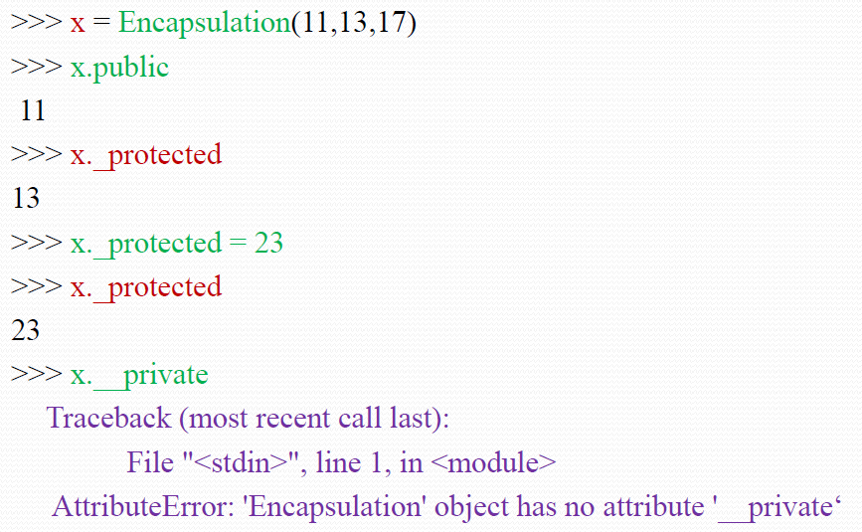
Public, Protected and Private
The following interactive sessions shows the behavior of public, protected and private members:

Slide 19
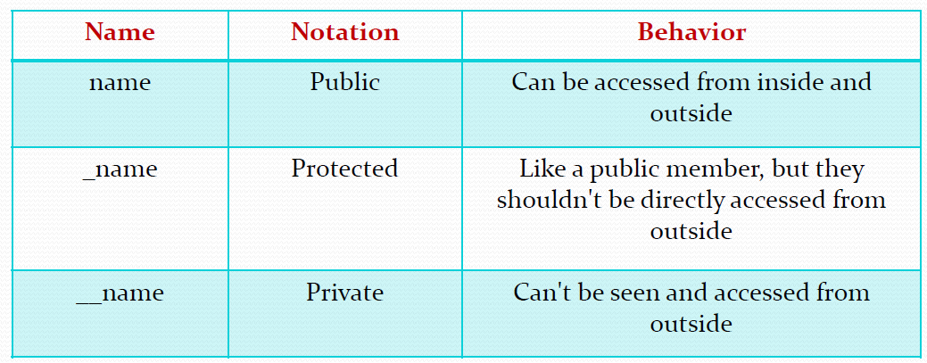
Public, Protected and Private
The following table shows the different behavior Public, Protected and Private Data:

Slide 20
Protected Members
Protected members (in C++ and JAVA) are those members of the class that cannot be accessed outside the class but can be accessed from within the class and its subclasses.
To accomplish this in Python, just follow the convention by prefixing the name of the member by a single underscore “_”.
Although the protected variable can be accessed out of the class as well as in the derived class(modified too in derived class), it is customary(convention not a rule) to not access the protected out the class body.

Slide 21
Protected Members
Example : Python program to demonstrate protected members
# Creating a base class
class Base:
def __init__(self):
# Protected member
self._a = 2
# Creating a derived class
class Derived(Base):
def __init__(self):
# Calling constructor of Base class
Base.__init__(self)
print("Calling protected member of base class: ", self._a)
# Modify the protected variable:
self._a = 3
print("Calling modified protected member outside class: ", self._a)

Slide 22
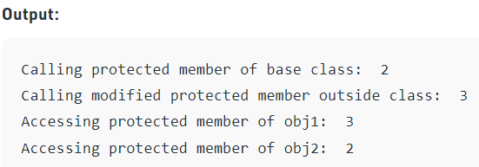
Protected Members
Example cont...
obj1 = Derived()
obj2 = Base()
# Calling protected member
# Can be accessed but should not be done due to convention
print("Accessing protected member of obj1: ", obj1._a)
# Accessing the protected variable outside
print("Accessing protected member of obj2: ", obj2._a)

Slide 23
Private Members
Private members are similar to protected members, the difference is that the class members declared private should neither be accessed outside the class nor by any derived class.
In Python, there is no existence of Private instance variables that cannot be accessed except inside a class.
However, to define a private member prefix the member name with double underscore “__”.
Python’s private members can be accessed outside the class through python name mangling.

Slide 24
Private Members
Example : Python program to demonstrate private members
# Creating a base class
class Base:
def __init__(self):
# Public member
self.a = “Welcome to Python”
# Private member
self.__c = “Welcome to Python”
# Creating a derived class
class Derived(Base):
def __init__(self):
# Calling constructor of Base class
Base.__init__(self)
print("Calling private member of base class: ")
print(self.__c)

Slide 25
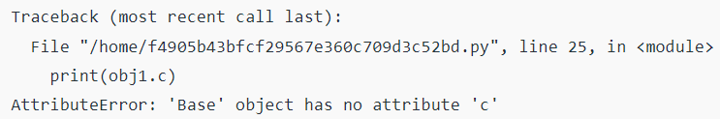
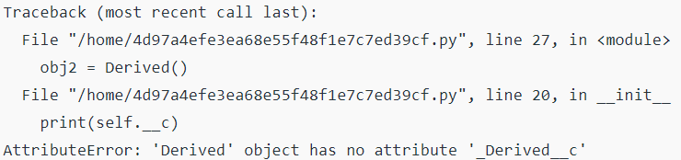
Private Members
Example cont...
# Driver code
obj1 = Base()
print(obj1.a) # Works fine
print(obj1.__c) # will raise an AttributeError
obj2 = Derived()
# will also raise an AtrributeError as private member of base class is called inside derived class

Slide 26
Naming Using Underscore(_)
Underscore(_) can be used to name variables, functions and classes, etc.
Single Pre Underscore:- _variable
Single Post Underscore:- variable_
Double Pre Underscores:- __variable
Double Pre and Post Underscores:- __variable__
_single_pre_underscore (_name)
Single Pre Underscore is used for internal use. Most of us don't use it because of that reason.
single pre underscore doesn't stop you from accessing the single pre underscore variable.
But, single pre underscore effects the names that are imported from the module.
class Test:
def __init__(self):
self.name = "datacamp"
self._num = 7 obj = Test()
print(obj.name) print(obj._num)
obj = Test()
print(obj.name)
print(obj._num)

Slide 27
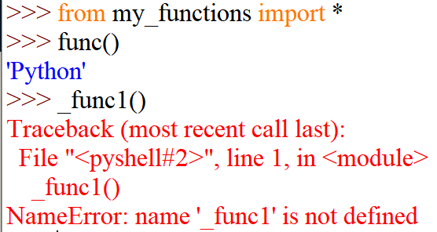
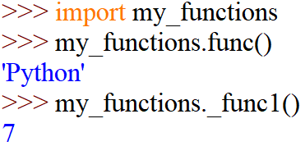
Naming Using Underscore(_)
_single_pre_underscore (_name) cont...
Create the following python file
Now, if you import all the methods and names from my_functions.py, Python doesn't import the names which starts with a single pre underscore.
## filename:- my_functions.py
def func():
return “Python"
def _func1():
return 7
To avoid this error, import module normally.

Slide 28
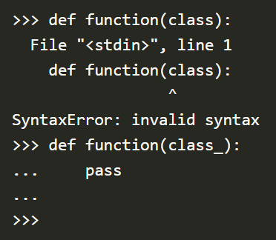
Naming Using Underscore(_)
single_post_underscore (name_)
Sometimes if you want to use Python Keywords as a variable, function or class names, you can use this convention for that.
You can avoid conflicts with the Python Keywords by adding an underscore at the end of the name which you want to use.
Ex:
Single Post Underscore is used for naming your variables as Python Keywords and to avoid the clashes by adding an underscore at last of your variable name.

Slide 29
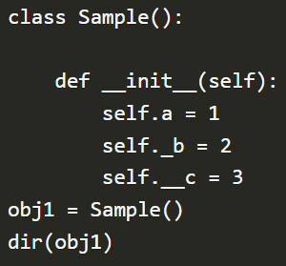
Naming Using Underscore(_)
Double Pre Underscore (__name)
Double Pre Underscores are used for the name mangling.
Name Mangling:- interpreter of the Python alters the variable name in a way that it is challenging to clash when the class is inherited.
Ex:
This code returns all the attributes of the class object.
self.a variable appears in the list without any change.
self._b Variable also appears in the list without any change.
Is there self.__c variable in the list?
If you carefully look at the attributes list, you will find an attribute called _Sample__c. This is the name mangling.

Slide 30
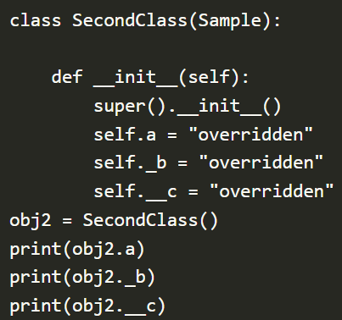

Naming Using Underscore(_)
Double Pre Underscore cont...
Let's create another class by inheriting Sample class to see how overriding works.
Ex:

Slide 31
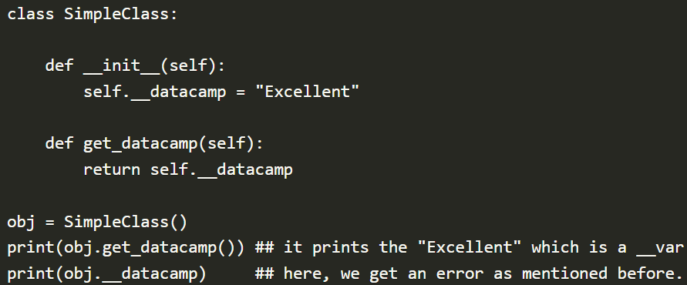
Naming Using Underscore(_)
Double Pre Underscore cont...
Can access the Double Pre Underscore variables using methods in the class
Ex:

Slide 32
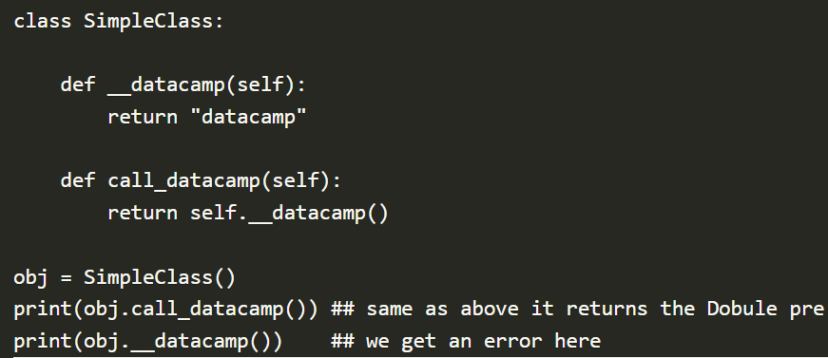
Naming Using Underscore(_)
Double Pre Underscore cont...
Can also use the Double Pre Underscore for the method names.
Ex:

Slide 33
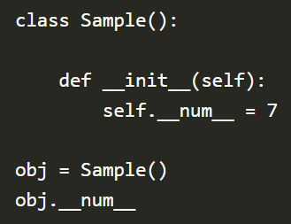
Naming Using Underscore(_)
Double Pre And Post Underscore (__name__)
In Python, you will find different names which start and end with the double underscore. They are called as magic methods or dunder methods.
Ex:

Slide 34
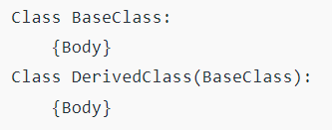
Inheritance
Inheritance is the capability of one class to derive or inherit the properties from another class.
Python Inheritance Syntax
Example:
class Point:
x = 0
y = 0
class Point3D(Point): # Point3D extends Point
z = 0
...
Notes:
34

Slide 35
Calling Superclass Methods
methods: class.method(object, parameters)
constructors: class.__init__(parameters)
class Point3D(Point):
z = 0
def __init__(self, x, y, z):
Point.__init__(self, x, y)
self.z = z
def translate(self, dx, dy, dz):
Point.translate(self, dx, dy)
self.z += dz
Notes:
35

Slide 36
Inheritance Example
class Person: # Parent class
# Constructor
def __init__(self, name):
self.name = name
# To get name
def getName(self):
return self.name
# To check if this person is an employee
def isEmployee(self):
return False
# Inherited or Subclass
class Employee(Person):
# Here we return true
def isEmployee(self):
return True
# An Object of Person
emp = Person(“John”)
print(emp.getName())
print(emp.isEmployee())
# An Object of Employee
emp = Employee(“Ram”)
print(emp.getName())
print(emp.isEmployee())
Notes:
36

Slide 37
Subclassing (Calling constructor of parent class)
A child class needs to identify which class is its parent class. This can be done by mentioning the parent class name in the definition of the child class.
Eg: class subclass_name(superclass_name):
# Python code to demonstrate how parent constructors are called.
# parent class
class Person:
def __init__(self, name, idnumber):
self.name = name
self.idnumber = idnumber
def display(self):
print(self.name)
print(self.idnumber)
# child class
class Employee(Person):
def __init__(self, name, idnumber, salary, post):
self.salary = salary
self.post = post
# invoking the constructor of parent class
Person.__init__(self, name, idnumber)
# creation of an object variable or an instance
a = Employee('Rahul', 886012, 200000, "Intern")
# calling a function of the class Person using its instance
a.display()
Notes:
37

Slide 38
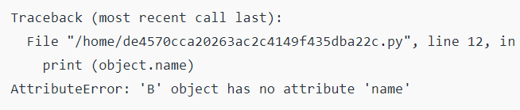
Subclassing (Calling constructor of parent class)
Python program to demonstrate error if we forget to invoke __init__() of the parent
If you forget to invoke the __init__() of the parent class then its instance variables would not be available to the child class.
class A:
def __init__(self, n='Rahul'):
self.name = n
class B(A):
def __init__(self, roll):
self.roll = roll
object = B(23)
print(object.roll) # No Error
print(object.name) # Error
Notes:
38

Slide 39
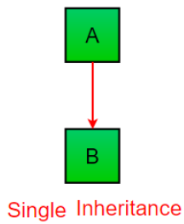

Types of Inheritance in Python
Single Inheritance: Single inheritance enables a derived class to inherit properties from a single parent class, thus enabling code reusability and the addition of new features to existing code.
# Python program to demonstrate single inheritance
# Base class
class Parent:
def func1(self):
print("This function is in parent class.")
# Derived class
class Child(Parent):
def func2(self):
print("This function is in child class.")
# Driver's code
object = Child() Output:
object.func1()
object.func2()
Notes:
39

Slide 40
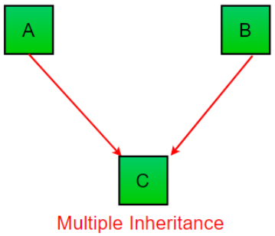
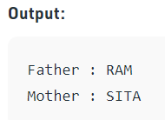
Types of Inheritance in Python
Multiple Inheritance: When a class can be derived from more than one base class this type of inheritance is called multiple inheritances. (Unlike java, python shows multiple inheritance.)
# Python program to demonstrate multiple inheritance
# Base class1
class Mother:
mothername = ""
def mother(self):
print(self.mothername)
# Base class2
class Father:
fathername = ""
def father(self):
print(self.fathername)
# Derived class
class Son(Mother, Father):
def parents(self):
print("Father :", self.fathername)
print("Mother :", self.mothername)
# Driver's code
s1 = Son()
s1.fathername = "RAM"
s1.mothername = "SITA"
s1.parents()
Notes:
40

Slide 41
Types of Inheritance in Python
Multiple Inheritance: When the method is overridden in both classes
Method Resolution Order (MRO) will take place from left to right.
class Class1:
def m(self):
print("In Class1")
class Class2:
def m(self):
print("In Class2")
class Class3(Class1, Class2):
pass
obj = Class3()
obj.m()
class Class1:
def m(self):
print("In Class1")
class Class2:
def m(self):
print("In Class2")
class Class3(Class2, Class1):
pass
obj = Class3()
obj.m()
Output: In Class1
Output: In Class2
NOTE: In the case of multiple inheritance, a given attribute is first searched in the current class if it’s not found then it’s searched in the parent classes. The parent classes are searched in a left-right fashion and each class is searched once.
Notes:
41

Slide 42
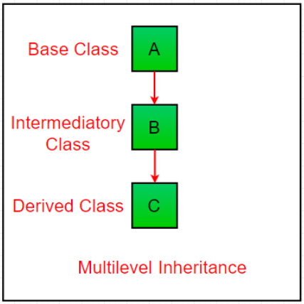
Types of Inheritance in Python
Multilevel Inheritance: In multilevel inheritance, features of the base class and the derived class are further inherited into the new derived class. This is like a relationship representing a child and a grandfather.
Notes:
42

Slide 43
Types of Inheritance in Python
# Python program to demonstrate multilevel inheritance
# Base class
class Grandfather:
def __init__(self, grandfathername):
self.grandfathername = grandfathername
# Intermediate class
class Father(Grandfather):
def __init__(self, fathername, grandfathername):
self.fathername = fathername
# invoking constructor of Grandfather class
Grandfather.__init__(self, grandfathername)
# Derived class
class Son(Father):
def __init__(self, sonname, fathername, grandfathername):
self.sonname = sonname
# invoking constructor of Father class
Father.__init__(self, fathername, grandfathername)
def print_name(self):
print('Grandfather name :', self.grandfathername)
print("Father name :", self.fathername)
print("Son name :", self.sonname)
# Driver code
s1 = Son('Prince', 'Rampal', 'Lal mani')
print(s1.grandfathername)
s1.print_name()
Notes:
43

Slide 44
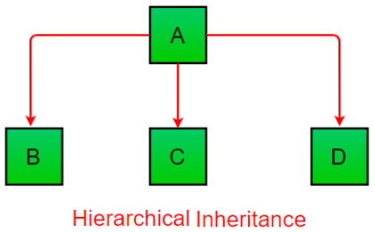
Types of Inheritance in Python
Hierarchical Inheritance: When more than one derived class are created from a single base class, this type of inheritance is called hierarchical inheritance.
# Python program to demonstrate Hierarchical inheritance
# Base class
class Parent:
def func1(self):
print("This function is in parent class.")
# Derived class1
class Child1(Parent):
def func2(self):
print("This function is in child 1.")
# Derived class2
class Child2(Parent):
def func3(self):
print("This function is in child 2.")
# Driver's code
object1 = Child1()
object2 = Child2()
object1.func1()
object1.func2()
object2.func1()
object2.func3()
Notes:
44

Slide 45
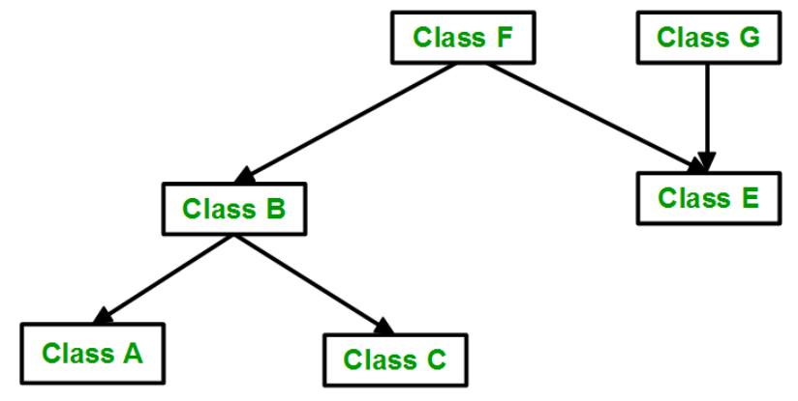
Types of Inheritance in Python
Hybrid Inheritance: Inheritance consisting of multiple types of inheritance is called hybrid inheritance.
Hybrid Inheritance
Multiple Inheritance
Notes:
45

Slide 46
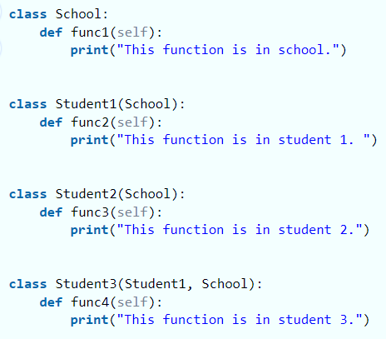
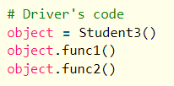
Types of Inheritance in Python
# Python program to demonstrate Hybrid inheritance
Notes:
46

Slide 47
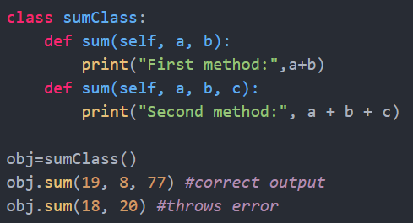
Function Overloading
Like other languages do, python does not support method overloading by default. But there are different ways to achieve method overloading in Python.
The problem with method overloading in Python is that we may overload the methods but can only use the latest defined method.
Example1:
Example 2:
Method1 (2 Args)
def product(a, b):
p = a * b
print(p)
>> Product(4,5) # Error
Method2 (3 Args)
def product(a, b,c):
p = a * b * c
print(p)
>> Product(2,3,4) # No error

Slide 48
How to Achieve Function Overloading in Python
Method1 :
If we want to implement the concept of function overloading, we need to set the default values of the parameters of the function as None. By setting the value of functional parameters as None, we get the option of calling the function either with or without the parameter.
Method2:
By Using Multiple Dispatch Decorator
Multiple Dispatch Decorator Can be installed by:
pip3 install multipledispatch

Slide 49
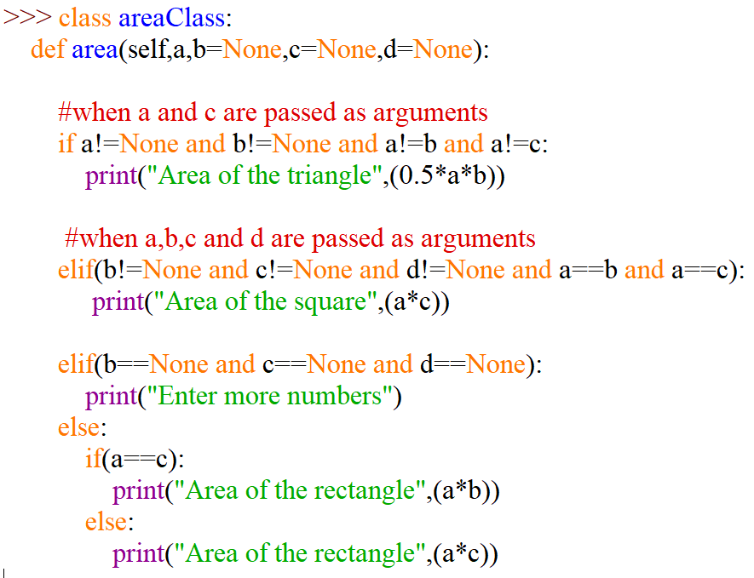
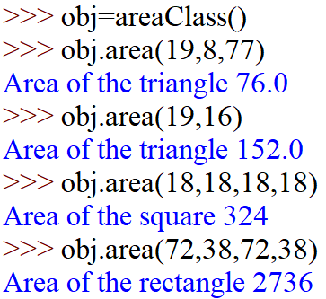
How to Achieve Function Overloading in Python
Using Method 1: Calculate the area of figures(triangle, rectangle, square).

Slide 50
How to Achieve Function Overloading in Python
Using Method 2: Using Multiple Dispatch Decorator
from multipledispatch import dispatch
#passing two parameter
@dispatch(int,int)
def product(first,second):
result = first*second
print(result);
#passing three parameters
@dispatch(int,int,int)
def product(first,second,third):
result = first * second * third
print(result);
#you can also pass data type of any value as per requirement
@dispatch(float,float,float)
def product(first,second,third):
result = first * second * third
print(result);
>> product(2,3)
>> Product(2,3,4)
>> product(2.2,3.4,2.3)

Slide 51
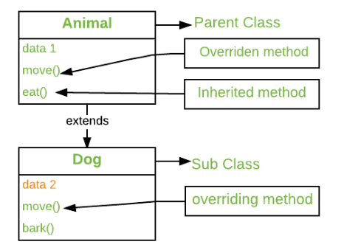
Method Overriding
Method overriding is an ability of any object-oriented programming language that allows a subclass or child class to provide a specific implementation of a method that is already provided by one of its super-classes or parent classes.
When a method in a subclass has the same name, same parameters or signature and same return type(or sub-type) as a method in its super-class, then the method in the subclass is said to override the method in the super-class.

Slide 52
Method Overriding
Method Overriding Example:
# Defining parent class
>> class Parent():
def __init__(self):
self.value = "Inside Parent"
# Parent's show method
def show(self):
print(self.value)
# Defining child class
>> class Child(Parent):
def __init__(self):
self.value = "Inside Child"
# Child's show method
def show(self):
print(self.value)
>> obj1 = Parent()
>> obj2 = Child()
>> obj1.show()
>> obj2.show()

Slide 53
Method Overriding with Multiple Inheritance
Method Overriding with Multiple Inheritance Example:
>> class Parent1():
# Parent1's show method
def show(self):
print("Inside Parent1")
>> class Parent2():
# Parent2's show method
def display(self):
print("Inside Parent2")
>> class Child(Parent1, Parent2):
# Child's show method
def show(self):
print("Inside Child")
obj = Child()
>> obj.show()
>> obj.display()

Slide 54
Method Overriding with Multilevel Inheritance
Method Overriding with Multilevel Inheritance Example:
>> class Parent():
# Parent's show method
def display(self):
print("Inside Parent")
>> class Child(Parent):
# Child's show method
def show(self):
print("Inside Child")
>> class GrandChild(Child):
# Child's show method
def show(self):
print("Inside GrandChild")
>> g = GrandChild()
>> g.show()
>> g.display()

Slide 55
Calling the Parent’s method within the overridden method
Parent class methods can also be called within the overridden methods. This can generally be achieved by two ways.
1. Using Classname: 2. Using Super()
class Parent():
def show(self):
print("Inside Parent")
class Child(Parent):
def show(self):
# Calling the parent's class
# method
Parent.show(self)
print("Inside Child")
# Driver's code
obj = Child()
obj.show()
class Parent():
def show(self):
print("Inside Parent")
class Child(Parent):
def show(self):
# Calling the parent's class
# method
super().show()
print("Inside Child")
# Driver's code
obj = Child()
obj.show()

Slide 56
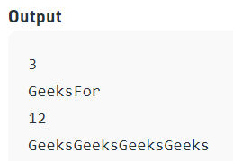
Operator Overloading
Operator Overloading means giving extended meaning beyond their predefined operational meaning. For example operator + is used to add two integers as well as join two strings and merge two lists.
# Python program to show use of + operator for different purposes.
>> print(1 + 2)
# concatenate two strings
>> print("Geeks"+"For")
# Product two numbers
>> print(3 * 4)
# Repeat the String
>> print("Geeks"*4)

Slide 57
How to Overload an Operator
To perform operator overloading, Python provides some special function or magic function that is automatically invoked when it is associated with that particular operator.
For example, when we use + operator, the magic method __add__ is automatically invoked in which the operation for + operator is defined.
Overloading binary + operator in Python :
When we use + operator, the magic method __add__ is automatically invoked in which the operation for + operator is defined.
There by changing this magic method’s code, we can give extra meaning to the + operator.

Slide 58
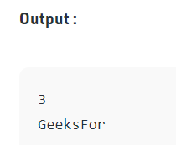
How to Overload an Operator
Program to overload binary + operator
class A:
def __init__(self, a):
self.a = a
# adding two objects
def __add__(self, o):
return self.a + o.a
ob1 = A(1)
ob2 = A(2)
ob3 = A("Geeks")
ob4 = A("For")
print(ob1 + ob2)
print(ob3 + ob4)

Slide 59
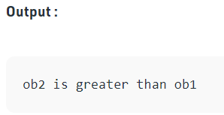
How to Overload an Operator
Program to overload comparison operators
Checking which object is greater
class A:
def __init__(self, a):
self.a = a
def __gt__(self, other):
if(self.a>other.a):
return True
else:
return False
ob1 = A(2)
ob2 = A(3)
if(ob1>ob2):
print("ob1 is greater than ob2")
else:
print("ob2 is greater than ob1")

Slide 60
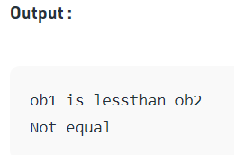
How to Overload an Operator
Overloading equality and less than operators :
>> class A:
def __init__(self, a):
self.a = a
def __lt__(self, other):
if(self.a<other.a):
return "ob1 is lessthan ob2"
else:
return "ob2 is less than ob1"
def __eq__(self, other):
if(self.a == other.a):
return "Both are equal"
else:
return "Not equal"
>> ob1 = A(2)
>> ob2 = A(3)
>> print(ob1 < ob2)
>> ob3 = A(4)
>> ob4 = A(4)
>> print(ob1 == ob2)

Slide 61
Exception Handling

Slide 62
Exceptions
What is an exception?
Even if a statement or expression is syntactically correct, it may cause an error when an attempt is made to execute it. Errors detected during execution are called exceptions

Slide 63
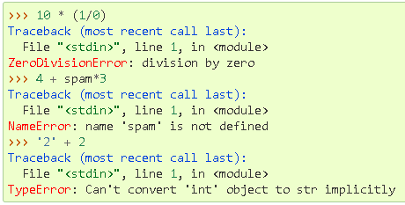
Exceptions
For Example

Slide 64
Handling Exceptions
It is possible to write programs that handle selected exceptions. Look at the following example, which asks the user for input until a valid integer has been entered, but allows the user to interrupt the program (using Control-C or whatever the operating system supports); note that a user-generated interruption is signalled by raising the KeyboardInterrupt exception.

Slide 65
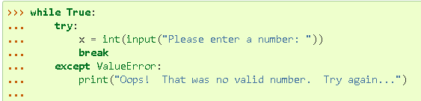
Handling Exceptions
For Example

Slide 66
Handling Exceptions
The try statement works as follows.
First, the try clause (the statement(s) between the try and except keywords) is executed.
If no exception occurs, the except clause is skipped and execution of the try statement is finished.

Slide 67
Handling Exceptions
The try statement works as follows.
If an exception occurs during execution of the try clause, the rest of the clause is skipped. Then if its type matches the exception named after the except keyword, the except clause is executed, and then execution continues after the try statement.

Slide 68
Handling Exceptions
The try statement works as follows.
If an exception occurs which does not match the exception named in the except clause, it is passed on to outer try statements; if no handler is found, it is an unhandled exception and execution stops with a message as shown above.

Slide 69
The except Clause with No Exceptions

Slide 70
The except Clause with No Exceptions
You can also use the except statement with no exceptions defined as follows:
try:
You do your operations here;
except:
If there is any exception, then execute this block…..
else:
If there is no exception then execute this block. Contd..

Slide 71
The except Clause with No Exceptions
This kind of a try-except statement catches all the exceptions that occur. Using this kind of try-except statement is not considered a good programming practice though, because it catches all exceptions but does not make the programmer identify the root cause of the problem that may occur.

Slide 72
Examples

Slide 73
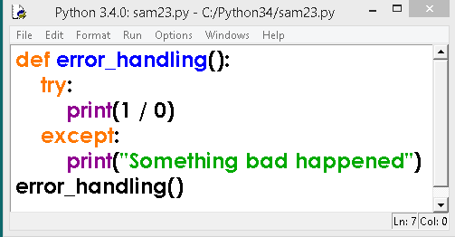
Example

Slide 74
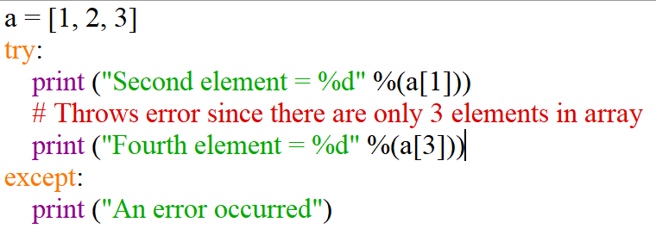
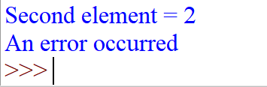
Example

Slide 75
Catching Specific Exception
A try statement can have more than one except clause, to specify handlers for different exceptions. Please note that at most one handler will be executed.
try:
# statement(s)
except IndexError:
# statement(s)
except ValueError:
# statement(s)

Slide 76
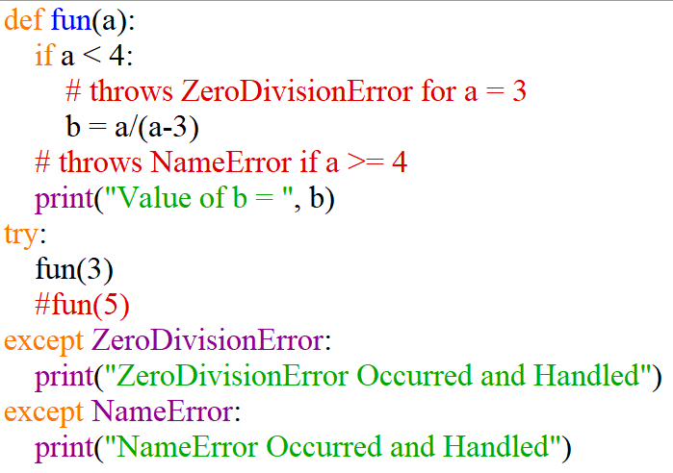
Example : Multiple Exception Handling

Slide 77
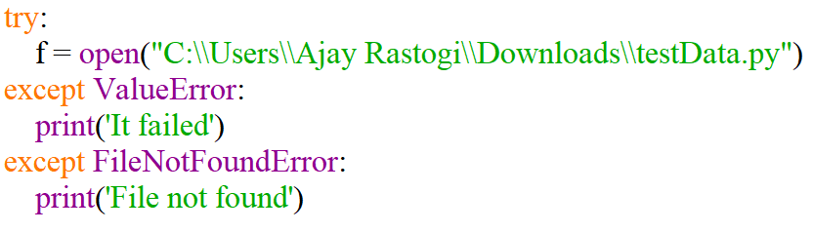

Example : Multiple Exception Handling

Slide 78
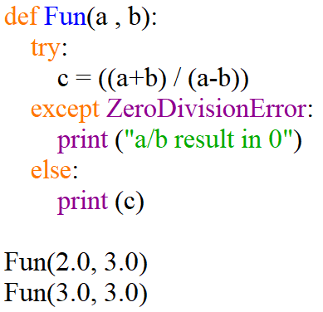
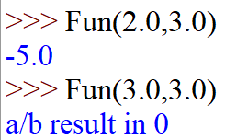
Try with Else Clause
In python, you can also use the else clause on the try-except block which must be present after all the except clauses. The code enters the else block only if the try clause does not raise an exception.

Slide 79
raise statement

Slide 80
raise statement
The raise statement allows the programmer to force a specific exception to occur. The sole argument in raise indicates the exception to be raised.
Raising an exception breaks current code execution and returns the exception back until it is handled.
Syntax:
raise [expression1[, expression2]]

Slide 81
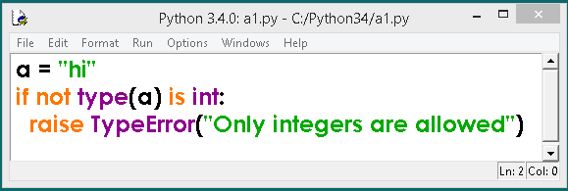
raise Example 1

Slide 82
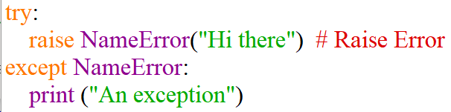

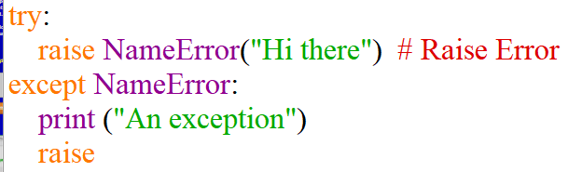
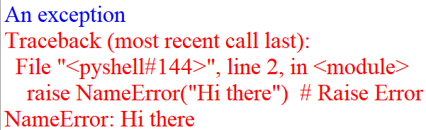
raise Example 2

Slide 83
Some common exceptions

Slide 84
Some common exceptions
IOError
If the file cannot be opened.
ImportError
If python cannot find the module.
ValueError
Raised when a built-in operation or function receives an argument that has the right type but an inappropriate value.

Slide 85
Some common exceptions
KeyboardInterrupt
Raised when the user hits the interrupt key (normally Control-C or Delete).
EOFError
Raised when one of the built-in functions (input() or raw_input()) hits an end-of-file condition (EOF) without reading any data

Slide 86
Thank You

